Slide 1
VAStra Store Sales
Analysis Project
2026
June
VAStra Store
Prepared By AMAN KUMAR

Slide 2
CONTENTS
01. Project Overview
02. Business Objectives
03. List of KPIs
04. Dashboard
05. Insights
06. Recommendations

Slide 3
PROJECT OVERVIEW
Goal is to analyze sales data to identify customer behavior, product performance, and revenue-driving factors
01.
Goal
Focus on customer segments, product categories, sales channels, and regional performance
02.
Focus
KPIs designed to track sales, orders, customer trends, delivery performance, and business growth
03.
KPIs

Slide 4
BUSINESS OBJECTIVES
Understand customer purchasing behavior, sales trends, and seasonal demand patterns across different months and demographics.
01.
Understand
Monitor sales performance across product categories, sales channels, states, and customer segments to identify top-performing areas.
02.
Monitor
Track key business KPIs including total sales, orders, customer contribution, delivery performance, and channel effectiveness to support business growth.
03.
Track

Slide 5
Solved KPIs
Total Sales
Total Customers
Total Orders
No of Delivery

Slide 6
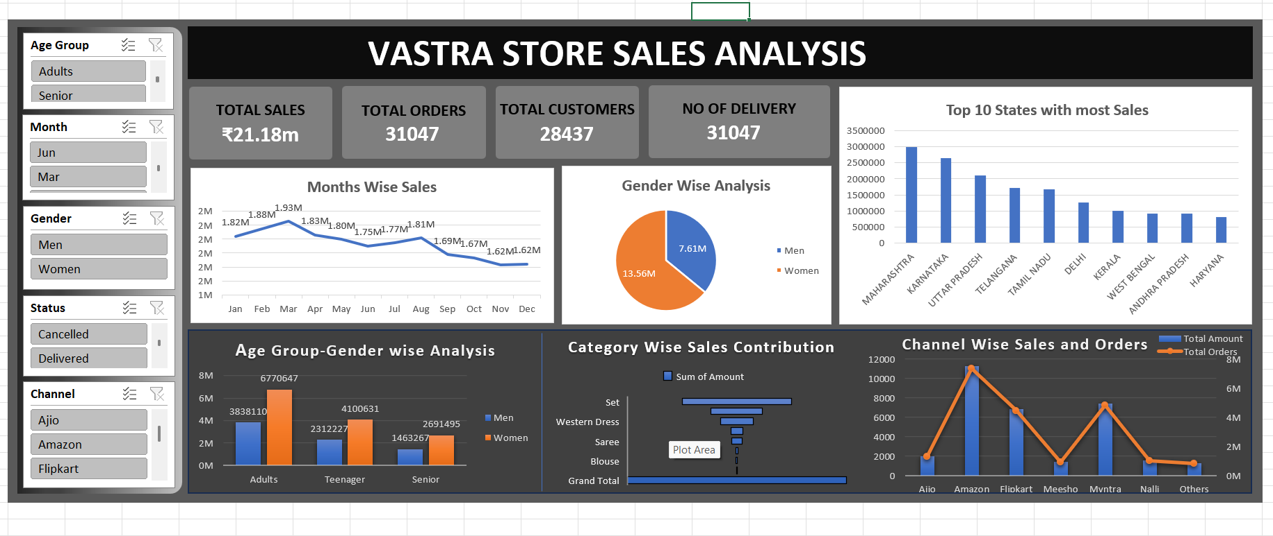
Excel Dashboard

Slide 7
KEY INSIGHTS
Sales are highest during March and August due to seasonal and festival demand.
01.
Women aged 30–50 are the primary contributors to overall revenue.
02.
Amazon, Myntra, and Flipkart drive the majority of sales and orders.
03.
Sets, Kurtas, and Western Dresses account for 88% of total sales
04.
Maharashtra, Karnataka, and Uttar Pradesh are the strongest performing markets
05.

Slide 8
RECOMMENDATIONS
1.
2.
3.
4.
5.
6.
Focus marketing campaigns during March and August to maximize sales during peak demand periods.
Target women aged 30–50 with personalized promotions, offers, and new product launches.
Strengthen sales through Amazon, Myntra, and Flipkart to increase customer reach.
Prioritize inventory for high-performing categories like Sets, Kurtas, and Western Dresses.
Increase marketing efforts in top-performing regions like Maharashtra, Karnataka, and Uttar Pradesh to drive further growth.
Use KPI dashboards for continuous sales and performance tracking.

Slide 9
THANK YOU!

